Slide 1
Iowa Local Government Risk Pool Commission
Education Energy Group Natural Gas Program

Slide 2
Frequently Asked Questions
What is a local government risk pool?
How does the Iowa Local Government Risk Pool Commission (Iowa LGRP) work?
What programs are offered by Iowa LGRP?
What is the Education Energy Group Program?
How are the premiums determined?
What happens if prices go up or down?
What happens if a rare event occurs, can my district be assessed for additional premium?
How does my district participate?
To whom do I address questions?

Slide 3
What is a local government risk pool?
A local government risk pool is a term used when governmental entities (such as cities, counties or school districts) join together in a group to collectively reduce costs, increase their buying power, or reduce risks.
A local government risk pool can be made between multiple school districts, between a school district and a city, or between various combinations & numbers of governmental entities.
The term local government risk pool is used and referenced in federal and state legislative code.
There are many examples of local government risk pools which involve Iowa school districts, such as cash management programs, health insurance pools, and many more.

Slide 4
How does the Iowa LGRP work?
The Iowa Local Government Risk Pool Commission (Iowa LGRP) is organized under Iowa Code Chapter 28E, and officially began in the fall of 2019 by three originating K-12 public school districts.
The Iowa LGRP has a Board of Directors responsible for oversight of the programs offered by the 28E.
Schools that wish to join the 28E must take official board action to approve an Application & Agreement to Join the Iowa LGRP. This action allows the district to become a member of the 28E entity.
Once a part of the 28E entity, the school district then has the option to participate in any program offered by the Iowa LGRP for a given school year or contract term.

Slide 5
What programs are offered by Iowa LGRP?
Currently, the Iowa LGRP offers only one program, called the Education Energy Group which is a natural gas risk management program for Iowa public school districts.
Iowa LGRP does not intend to create any other programs or invite governmental entities other than Iowa public school districts into the organization at this point in time, though the 28E Agreement authorizes it to do so. The Board of Directors would have the authority to expand programs in the future.

Slide 6
What is the Education Energy Group Program?
Districts remit a single lump sum premium payment at the beginning of the fiscal year for each enrolled meter.
This premium covers all gas service requirements for the year (from utility expenses to the gas itself). Participants receive no gas utility bills.
The premium is based on historical usage, calculated at the gas prices the Iowa LGRP procures, plus a risk premium to establish a fixed budget. The wholesale gas cost itself is passed through to the premium with no additional markup.
All risks are then transferred to service providers so the district has budget certainty and known heating costs for the fiscal year.
As with other products that transfer risk, there is a tradeoff between cost and certainty. In most years, your district may not save money, but it will protect you from rare events such as super cold winters or the impact of hurricanes reducing production or other items that send costs soaring.

Slide 7
What is the Education Energy Group Program?
This is not an insurance program, according to the Iowa Insurance Division and Iowa laws. Rather, this is a local government risk pool through which governmental entities join together to pool and transfer risks.
According to an opinion issued by Iowa’s Auditor of State, the premium may be paid from the district’s Management Fund.
If premiums are paid from the district’s Management Fund, that will also ensure your General Fund will not be impacted regardless of weather events or other gas market supply issues, independent of any long run overall savings.
It’s important to note that the Iowa Department of Education has not issued an opinion on the use of the Management Fund for this program.

Slide 8
How are the premiums determined?
School gas expenditures historically are calculated by taking usage for each meter multiplied by the price of the gas itself (which includes margin for the gas supplier), transportation, tariffs, taxes, and administrative fees.
Anticipated usage for each meter is determined by reviewing historical information and taking into account any known material changes anticipated by the school district (such as a building opening or closing).
The Iowa LGRP service providers lock in gas purchases for pool participants at a fixed price for the gas itself. The service providers assume the risk associated with winter heating needs that exceed historical usage.
The transportation costs, tariffs, taxes and administrative fees from the utilities are generally known, however they can change. The risk of any changes would be borne by the service providers.
The Iowa LGRP limits underwriting profits of its service providers. In the event that profits exceed the profit threshold, Iowa LGRP is empowered to distribute refunds of excess premium back to participants.

Slide 9
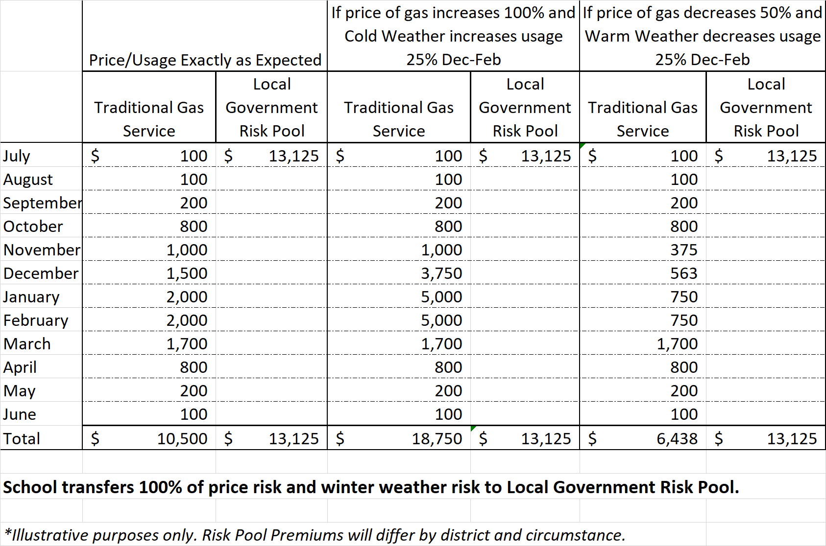
What happens if prices go up or down?
If pricing & usage are exactly as anticipated, the school pays slightly more.
If pricing & usage increase, school pays significantly less.
If pricing & usage decrease, school pays significantly more.
But in all scenarios, school has budget certainty knowing their annual premium, and has protected their General Fund.

Slide 10
What happens if a rare event occurs, can my district be assessed for additional premium?
The total premium defined in the Participation Agreement is the entire amount a school district will owe for participating meters during the term of the Agreement, unless the district experiences a “material event”.
The definition of a material event is defined in the Participation Agreement but includes adding or removing a building, changing equipment, etc. It is important to notify the service providers right away if you experience or anticipate experiencing a material event during the term. Material events may result in an additional premium owed or a refund of premium.
Outside of material events, there will be no additional charges or assessments to the district. Risks are borne by the service providers.
The Participation Agreement commits a district for participation only for the term defined in the Agreement. The district can choose whether or not they wish to participate in subsequent fiscal years with new Participation Agreements.

Slide 11
How does my district participate?
First, contact ISFIS or Wood River Energy for a personalized Participation Agreement and make sure all of your questions are answered.
Let us know which meters you wish to enroll.
If you haven’t worked with Wood River Energy previously, we’ll need to obtain historical information.
We’ll send you a personalized Participation Agreement and the documents linked below for board approval.
Join the Iowa LGRP 28E entity
Iowa LGRP 28E Agreement and First Amendment (for your information)
Application and Agreement to Join the Iowa LGRP 28E (for board approval)
Resolution approving the 28E Agreement, and the Application and Agreement to Join the 28E (for board approval)
Participate in the Education Energy Program for the fiscal year
Personalized Participation Agreement (for board approval)

Slide 12
What happens next?
Submit your completed and approved documents to ISFIS (jen@iowaschoolfinance.com)
Application and Agreement to Join the 28E
Resolution Approving the 28E Agreement and Application
Participation Agreement for the year
You’ll want to send a copy of these documents to your school district auditor for their information
You’ll receive an invoice for payment from Iowa LGRP for the total premium defined in the Participation Agreement.
Notify ISFIS or Wood River Energy right away if you have a material change to any of the meters enrolled in the program.
Each year, the district will only need to approve a new Participation Agreement for the upcoming fiscal year.
That’s it! No additional work is required by your district!

Slide 13
To whom do I address questions?
If you have questions regarding documents requiring board approval, school finance issues, using the management fund, implications to your audit or certified budget, contact ISFIS:
Jen Albers, jen@iowaschoolfinance.com, (515) 251-5970 x4
Jon Muller, jon@iowaschoolfinance.com, (515) 251-5970 x7
Larry Sigel, larry@iowaschoolfinance.com, (515) 251-5970 x3
If you have questions about your natural gas meters, historic usage or pricing, material changes anticipated to your meter, enrolling or removing meters, etc., contact Wood River Energy:
Don Krattenmaker, don.krattenmaker@woodriverenergy.com, (888) 510-9315

